Slide 1


TWITTER SENTIMENT ANALYSIS
This presentation uses predictive models to analyze Twitter sentiment for insights into public opinion and trends.

Slide 2





INTRODUCTION
Analyzing public sentiment on Twitter
Tracking sentiment trends over time
Leveraging natural language processing techniques to understand the overall mood and opinions expressed by Twitter users on various topics
Monitoring how public sentiment evolves on Twitter, capturing changes in mood and opinions on current events and issues
Uncovering influential topics and discussions
Identifying positive, negative, and neutral sentiments
Identifying the key topics, keywords, and themes that are driving significant sentiment on Twitter
Classifying tweets as expressing positive, negative, or neutral sentiment
This introductory slide provides an overview of the sentiment analysis approach that will be explored in the 'Tweet Sense' presentation, highlighting the insights that can be gained from examining public sentiment on Twitter.

Slide 3

PROBLEM STATEMENT
Define the Problem
Identify the key objectives of understanding public sentiment and how it can inform data-driven decision-making.
Explore Twitter Data
Gather and analyze Twitter data to understand the current public sentiment on relevant topics or issues.
Develop Sentiment Analysis Model
Design and implement a sentiment analysis model that can accurately classify tweets as positive, negative, or neutral.
Interpret Insights
Analyze the sentiment insights to identify patterns, trends, and key drivers of public opinion that can inform data-driven decisions.

Slide 4




DATASET DETAILS
Twitter Tweets
Sentiment Labels
Metadata
The dataset consists of tweets collected from the Kaggle Dataset.
Each tweet is labeled with one of the sentiment categories: Positive, Negative, Neutral, or Irrelevant.
The dataset includes metadata such as tweet ID, Sentiment, Entities, and Tweet Context,
The dataset provides a comprehensive set of tweets with sentiment labels and metadata, enabling in-depth analysis of user sentiment on the Twitter platform.

Slide 5

SENTIMENT
Sentiment Classification
The process of categorizing the sentiment expressed in a tweet into predefined categories such as Positive, Negative, Neutral, or Irrelevant.
Positive Sentiment
Tweets expressing a favorable or approving attitude towards a topic or subject.
Negative Sentiment
Tweets expressing an unfavorable or disapproving attitude towards a topic or subject.
Neutral Sentiment
Tweets that do not express a clear positive or negative sentiment, but rather a neutral or objective viewpoint.
Irrelevant Sentiment
Tweets that do not contain any meaningful sentiment towards the topic of interest and are considered irrelevant for the analysis.

Slide 6

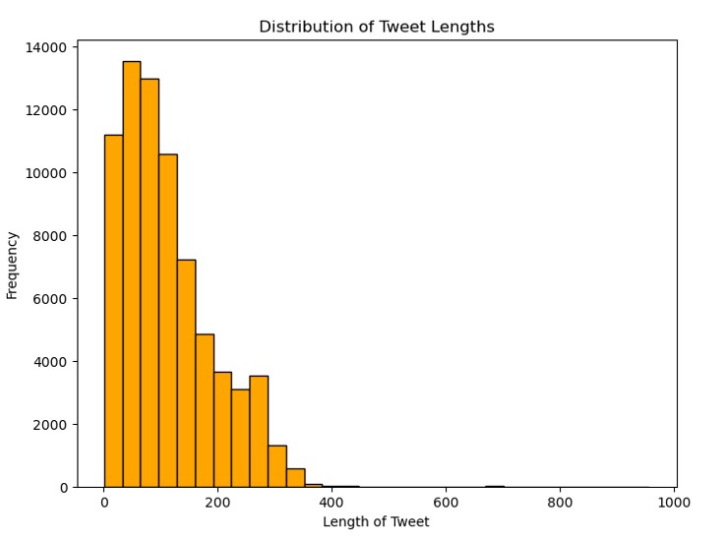
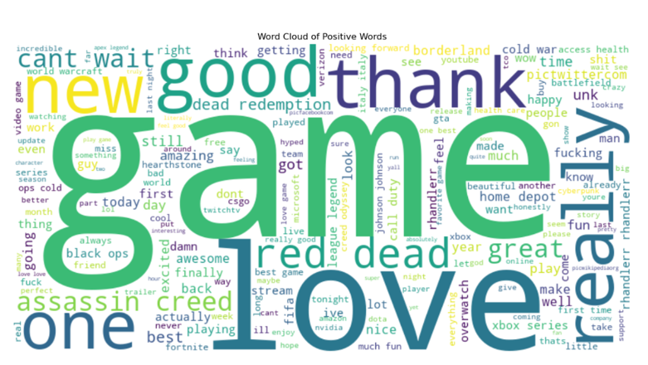
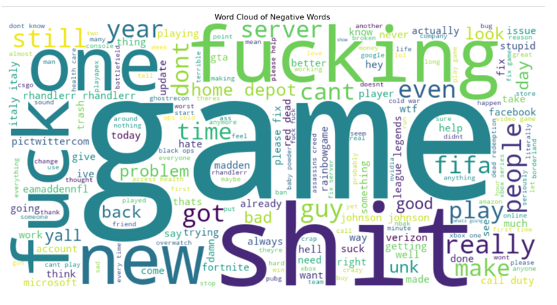
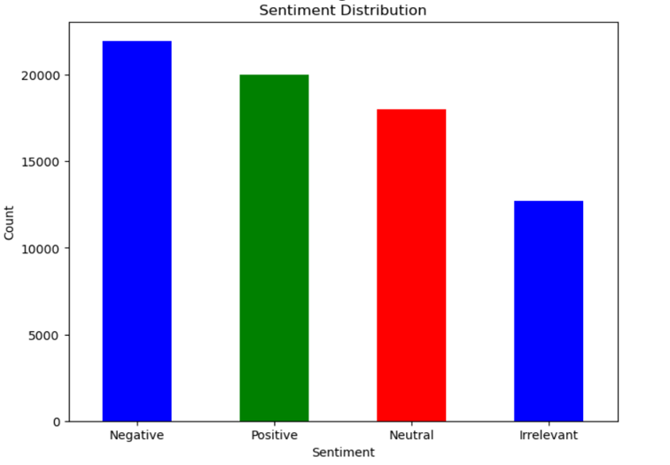
DATA EXPLORATION AND INTIAL INSIGHTS
SENTIMENT DISTRIBUTION
TWEET LENGTH HISTOGRAM
WORD CLOUD OF POSITVE TERMS
WORD CLOUD OF NEGATIVE TERMS
A histogram showing the distribution of positive, negative, and neutral sentiment scores across the Twitter data.
A histogram depicting the distribution of tweet lengths, provides insights into the typical length of tweets in the dataset.
A visually appealing positive word cloud highlighting the most frequently used terms in the Twitter data, allowing for the identification of popular topics and themes.
A visually appealing negative word cloud highlighting the most frequently used terms in the Twitter data, allowing for the identification of popular topics and themes.

Slide 7




DATA PREPROCESSING
Combining Dataset
Text Preprocessing
Feature Engineering
Data Collection
Data Cleaning
Used a Kaggle dataset with representative and diverse tweets, including Tweet_ID, Entity, Sentiment, and Tweet_content fields
Removed irrelevant or duplicate tweets, handle missing values, and correct any typographical errors or inconsistencies in the data.
Performed text preprocessing techniques such as converting text to lowercase, removing stop words, handling punctuation, and applying stemming or lemmatization to standardize the text.
Extract relevant features from the tweet text, such as the presence of URLs, hashtags, mentions, and sentiment-related words, to prepare the data for analysis.
The training and validation datasets were merged into one, labeled by source (Train and Validation), reset, and sampled for verification

Slide 8

MODEL SELECTION
Evaluate Model Performance
Identify Top-Performing Model
Validate Model Robustness
Assess the performance of each candidate model using relevant metrics such as accuracy, precision, recall, and F1-score.
Recommend the model with the highest overall performance as the top-performing model for deployment.
Ensure the selected model is robust and can handle a variety of input data and edge cases.
Analyze Feature Importance
Assess Deployment Feasibility
Investigate the feature importance to understand the key drivers of the model's predictions.
Evaluate the feasibility of deploying the selected model in the production environment, considering factors like computational resources and integration requirements.

Slide 9

MODEL EVALUATION
Accuracy of sentiment analysis models on Twitter data
Logistic Regression
83%
Bernoulli Navie Byers
80%
Multinomial Naive Bayes
86%
LinearSVC
89%

Slide 10




CONCLUSION
SUMMARY OF ANALYSIS
POTENTIAL CHALLENGES
Provided an overview of the sentiment analysis conducted on the Twitter data, including insights on the overall sentiment trends, key drivers of positive and negative sentiment, and implications for the business.
Highlighted potential challenges such as dealing with evolving Twitter data, addressing biases in the training data, and ensuring the model remains robust over time.
POTENTIAL OPPORTUNITIES
CHOSEN MODEL FOR DEPLOYMENT
Identified opportunities to enhance the sentiment analysis, such as incorporating additional data sources, leveraging natural language processing techniques, and automating the model deployment and monitoring processes.
Determined that the LinerarSVC classifier model provided the best performance in terms of accuracy, precision, and recall, and is recommended for deployment.
THE SENTIMENT ANALYSIS CONDUCTED ON THE TWITTER DATA PROVIDED VALUABLE INSIGHTS THAT CAN INFORM BUSINESS DECISIONS. THE LINEARSVC CLASSIFIER MODEL IS RECOMMENDED FOR DEPLOYMENT, BUT ONGOING MONITORING AND REFINEMENT WILL BE NECESSARY TO ADDRESS POTENTIAL CHALLENGES AND CAPITALIZE ON EMERGING OPPORTUNITIES.

Slide 11





Incorporate Customer Sentiment Analysis
Enhance Feature Engineering with Geospatial Data
Future Enhancements
Leverage Ensemble Modeling Techniques
Improve Real-Time Churn Prediction Capabilities

